Slide 1

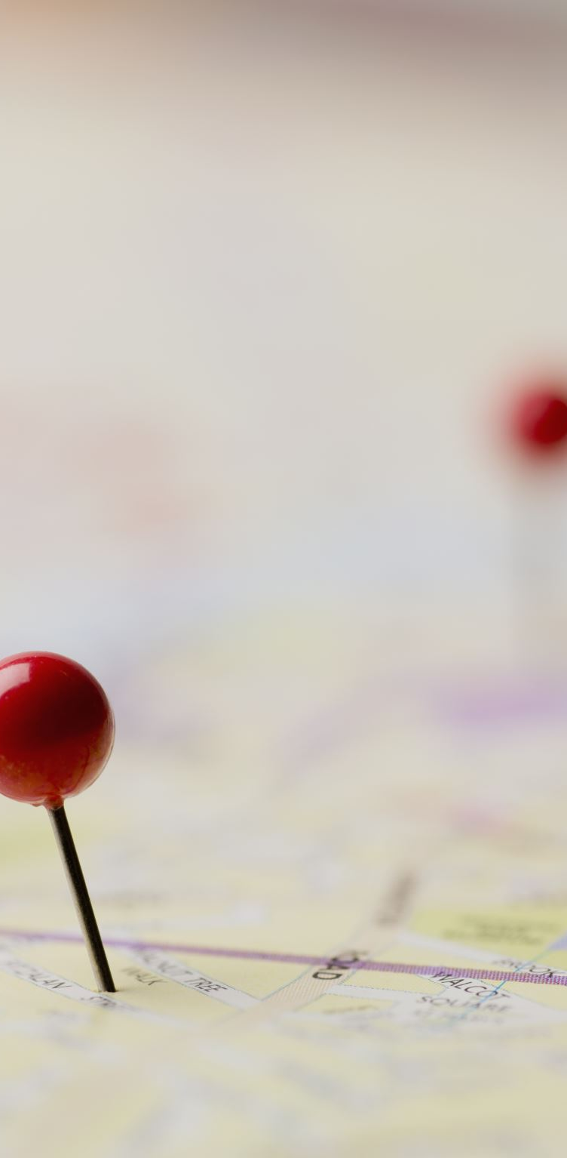
Location detecting system
Mizuki Kakei

Slide 2
Agenda
Objects
Dataset
Goals
Methods of analysis
Results
Summary and Outlook

Slide 3
Objects
This project is about creating location detecting system to navigate people inside the campus. Since GPS does not work well inside the building, Wifi finger print system is used. This system is based on detecting strength of signals between phones and multiple Wifi spots.

Slide 4
How this is possible ?
Strength
Distance
≃

Slide 5
Data set
520 WAPs ( 55 columns were excluded )
Location
- Floor, Longitude, Latitude, Building, Space ID, Relative position
with respect to Space ID
Information of the users
- User ID, Phone ID
Time Stamp

Slide 6
Goals
Examining different algorithms and finding the best machine learning models with high accuracy of
Longitude
Latitude
Floor
Building

Slide 7
Methods of Analysis
 | KNN | SVM | Random Forest
PCAs | 99% | 97% | 99.5%
No PCAs | 98% | 99% | 99.5%
Modeling
PreProcessing

Slide 8
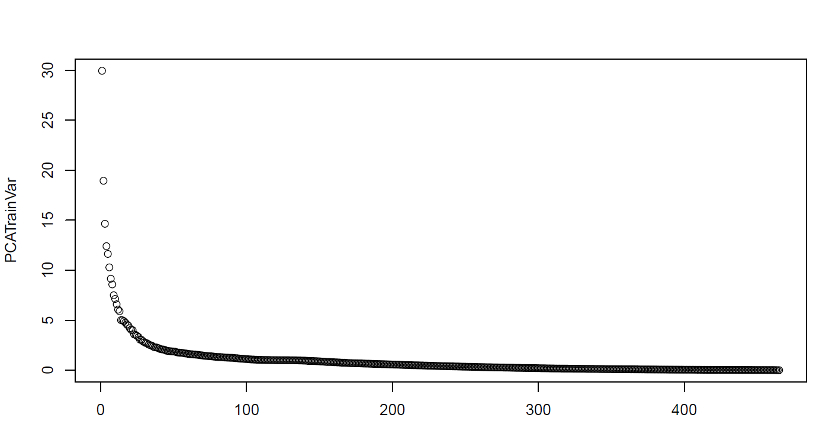
Principal Component Analysis
90%
206 columns

Slide 9
Floor Prediction Accuracy
 | KNN | SVM | Random Forest
PCAs | 69% | 71% | 76%
No PCAs | 73% | 76% | 90%
Modeling
PreProcessing

Slide 10
Building Prediction Accuracy
 | KNN | SVM | Random Forest
PCAs | 99% | 97% | 99.5
No PCAs | 98% | 99% | 99.5
Modeling
PreProcessing

Slide 11
LONGITUDE Prediction Accuracy
 | KNN | SVM | Random Forest
PCAs | 97% | 1% | 99.2%
No PCAs | 95% | 0.1% | 98%
Modeling
PreProcessing

Slide 12
LATITUDE Prediction Accuracy
 | KNN | SVM | Random Forest
PCAs | 94% | 0.4% | 97%
No PCAs | 93% | 0.2% | 97%
Modeling
PreProcessing

Slide 13
Best results of Accuracy
 | Validation Accuracy
Floor (No PCs, RF) | 90%
Building (No PCs, RF) | 99.5%
Longitude (PCs, RF) | 99.2%
Latitude (No PCs, RF) | 97%

Slide 14
Summary and Outlook
Randomforest performed the best results
Accuracy of Floor should be improved
Detecting Outliers

Slide 15
Thank you

